Slide 1





HOTEL BOOKINGS
ANALYSIS
TravClan Business Analyst Intern Assignment
Aayush Raj Giri
21 September, 2025

Slide 2

KEY OBSERVATIONS
OVERVIEW OF BOOKING TRENDS, CITY PERFORMANCE, AND REVENUE PATTERNS.
Identified peak booking months and cancellation rates.
Analyzed city-wise booking performance.
Tracked revenue trends with moving averages.

Slide 3
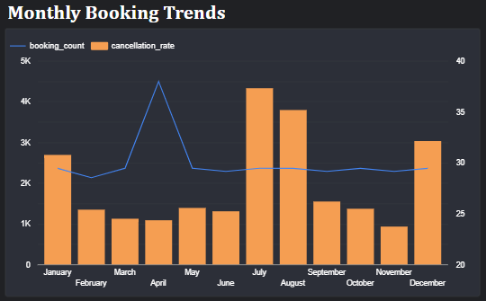
MONTHLY BOOKING
TRENDS
The analysis reveals a significant peak in April 2024 with 1,200 bookings and a 37% cancellation rate, suggesting seasonal demand fluctuations and potential overbooking issues.

Slide 4
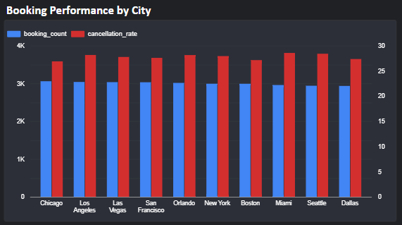

BOOKING
PERFORMANCE
BY CITY
Highlight the top-performing cities based on booking_count and cancellation_rate from the "Bookings by City" data source.

Slide 5
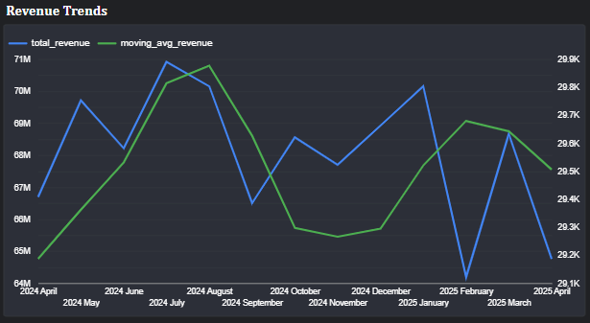
REVENUE
TRENDS
This slide showcases the revenue trends over time, comparing total revenue with a moving average to identify general patterns and potential seasonal influences. The visualization helps in understanding the financial performance and spotting areas where revenue growth may require strategic attention

Slide 6
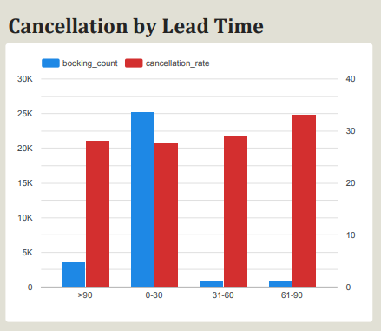
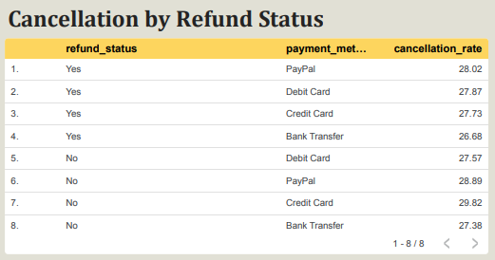
CANCELLATION
BEHAVIOR
This slide explores cancellation patterns by examining the relationship between lead time and cancellation rates, as well as the impact of refund status on booking cancellations. The visualizations provide insights into customer behavior and potential areas where cancellation policies could be optimized.

Slide 7
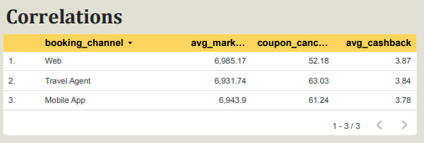
ROOT CAUSE
ANALYSIS
This slide investigates the underlying factors contributing to cancellations by examining correlations between booking channels and key metrics. The visualization offers a broad perspective on how pricing strategies and promotional activities might influence cancellation rates, aiding in the identification of actionable improvements.

Slide 8


THANK YOU
FOR YOUR ATTENTION
Concluding a detailed analysis of TravClan’s 2024 booking data, this slide synthesizes insights from the visualizations.
AAYUSH RAJ GIRI

